Slide 1


Software as a Service (SaaS)
Subject Name: Platform Based Development
Subject Code: PBDV301 | PBDE401
Lecturer Name : Freedom
Department : Information Technology

Slide 2
Outline of the lesson
Objectives
Critically differentiate SaaS from traditional and other cloud service models.
Architect a basic multi-tenant SaaS system and justify design trade-offs.
Quantitatively evaluate SaaS performance using financial and growth metrics.
Analyze scalability constraints and propose DevOps solutions.
Assess security and compliance (risk management frameworks) in SaaS.
Evaluate SaaS market positioning (Horizontal vs Vertical SaaS).

Slide 3
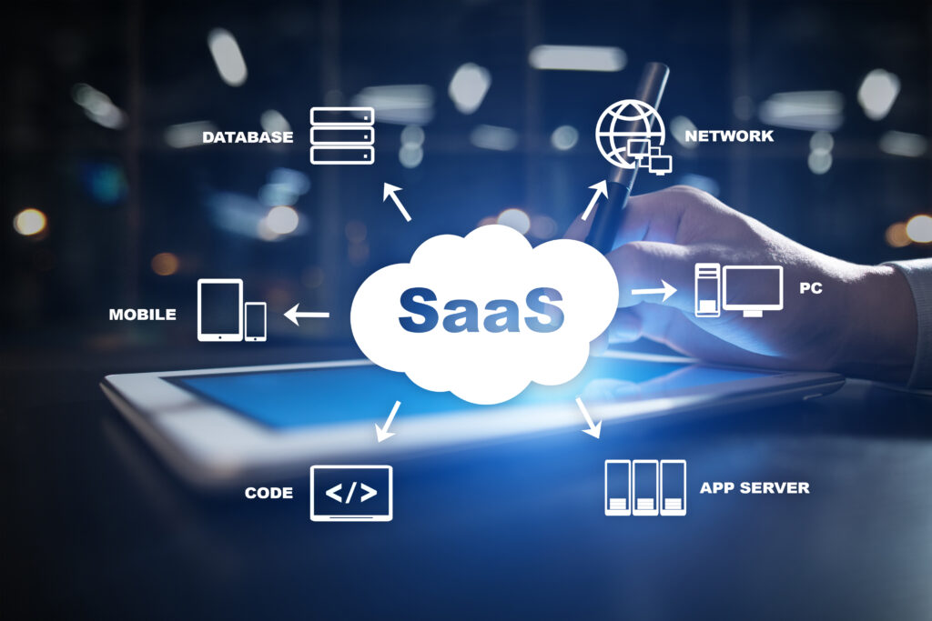
Software as a Service (SaaS)
Software-as-a-Service is a licensing model in which access to an software and application is provided to the customer or client on a subscription basis.
Accessed with a web browser over the internet.
SaaS runs on top of PaaS that in turn runs on top of IaaS.
A third-party vendor controls access and takes responsibility for security, maintenance, and feature upgrades.

Slide 4
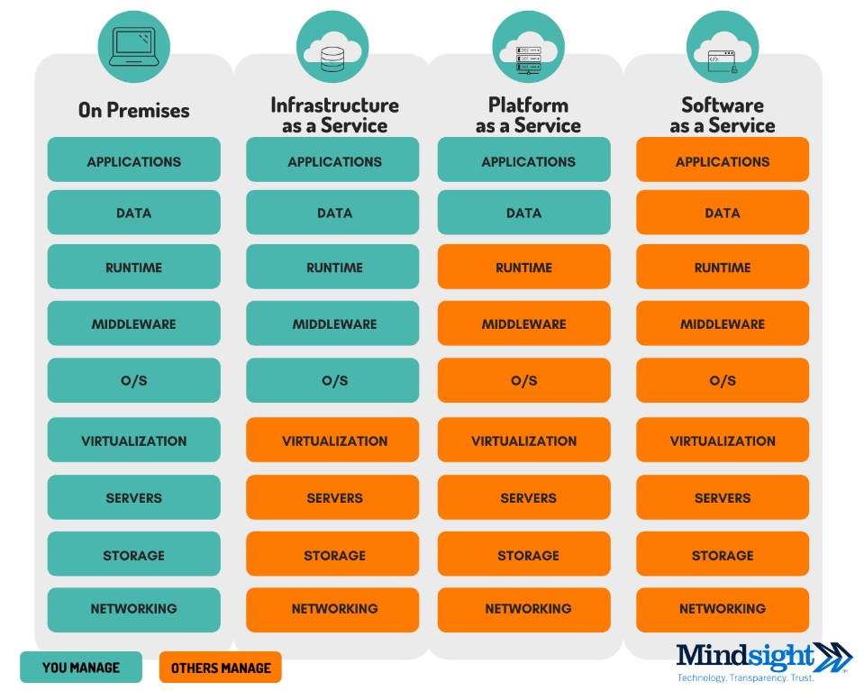
Software as a Service (SaaS)
Third Party Responsibility (Cloud Provider)

Slide 5
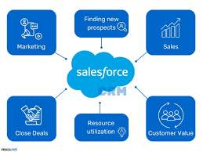
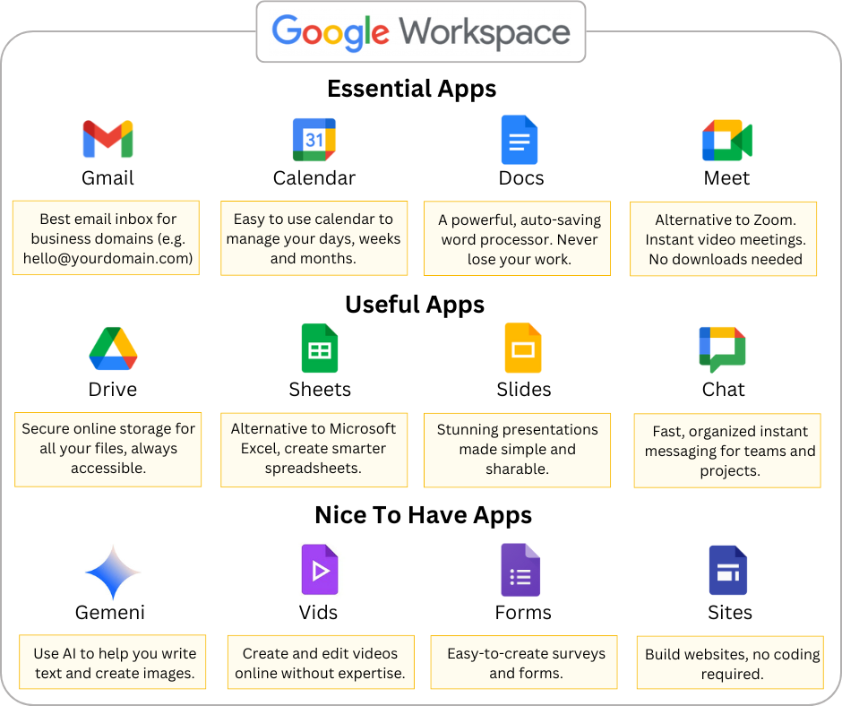
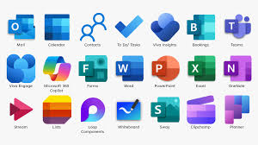
Software as a Service (Examples)

Slide 6

Question
Which economic shift MOST enabled SaaS dominance in enterprise markets?
A) Faster CPUs
B) Transition from CapEx to OpEx spending models
C) Growth of open-source software
D) Desktop virtualization

Slide 7
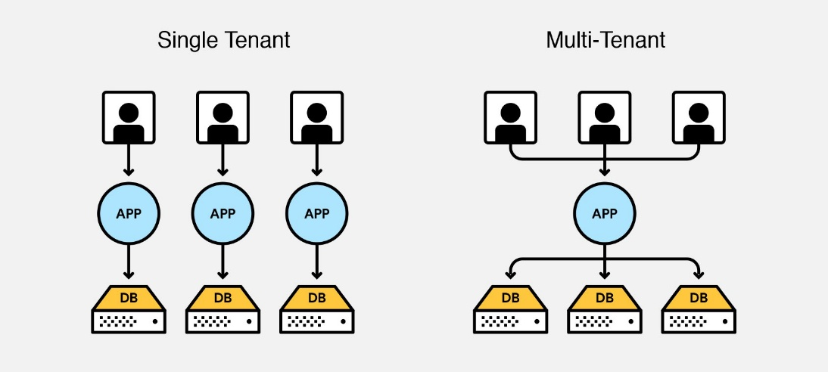
Software as a Service (SaaS)
SaaS Architecture
Multi-Tenant vs Single-Tenant Design
SaaS architecture defines how:
Application logic is structured
Infrastructure is provisioned
Tenants (customers) are isolated
Scalability and performance are maintained
2, ttps://www.igloosoftware.com/blog/multi-tenancy-database/

Slide 8
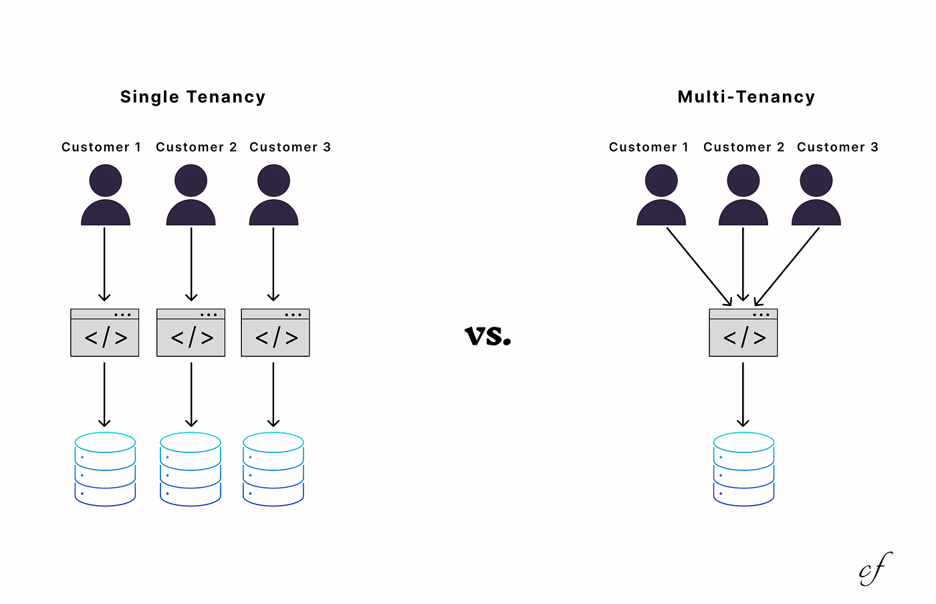
Software as a Service (SaaS)
Multi-Tenant Architecture
  A single application instance serves multiple customers (tenants) and the supporting infrastructure
      Share infrastructure
      Share application code
      Are logically isolated at the data level
Data Isolation Patterns
Shared Database + Tenant ID
Shared Databased + Separate Schema
Separate Database per Tenant

Slide 9
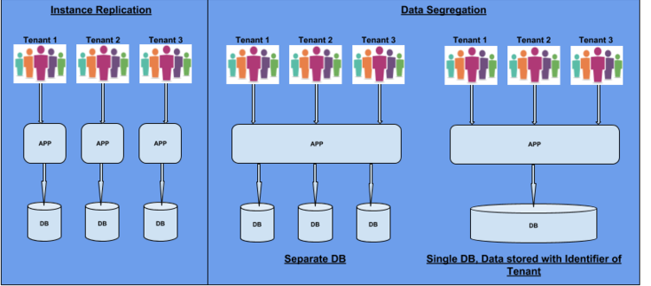
Software as a Service (SaaS)

Slide 10
Software as a Service (SaaS)
Single-Tenant Architecture
Each customer (tenant) gets:
A dedicated application instance
Dedicated database
Sometimes dedicated infrastructure
Deployment Modes
  Separate virtual machines per tenant
  Container per tenant
  Fully isolated cloud environments

Slide 11
Software as a Service (SaaS)
Direct Comparison
Factor | Multi-Tenant | Single-Tenant
Cost | Low | High
Scalability | Very High | Moderate
Isolation | Logical | Physical
Customization | Limited | Extensive
Maintenance | Centralized | Distributed
Compliance | More complex | Easier

Slide 12
Question
A SaaS startup targets healthcare enterprises requiring HIPAA compliance but also wants strong cost efficiency. Which approach is MOST strategically balanced?
A) Fully shared database multi-tenant
B) Dedicated servers and codebase per tenant
C) Shared application layer with separate database per tenant
D) Single shared database without row-level isolation

Slide 13
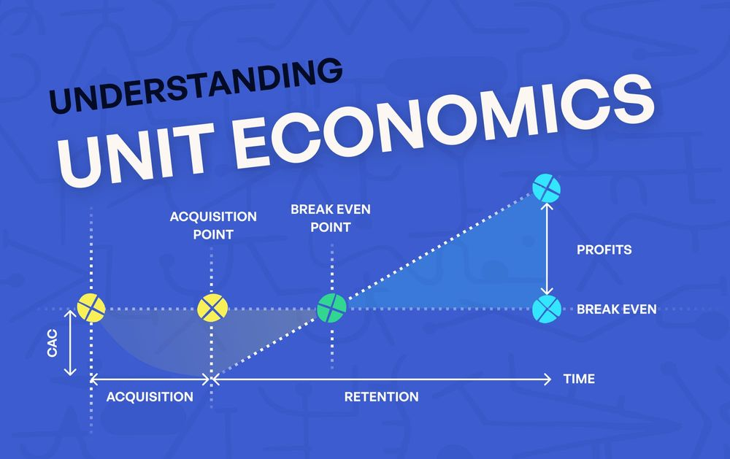
Software as a Service (SaaS)
SaaS Financial Model & Unit Economics
SaaS success depends on unit economics, whether each customer generates more lifetime value than it costs to acquire them.
SaaS businesses often lose money upfront and recover revenue over time through subscriptions.
Core Metrics
MRR (Monthly Recurring Revenue) - Predictable monthly subscription income.
CAC (Customer Acquisition Cost)
Churn Rate
LTV (Lifetime Value)

Slide 14
Question
A SaaS firm reduces churn from 6% to 3%. What happens to LTV?
A) Doubles
B) Increases by 50%
C) Triples
D) Remains constant

Slide 15
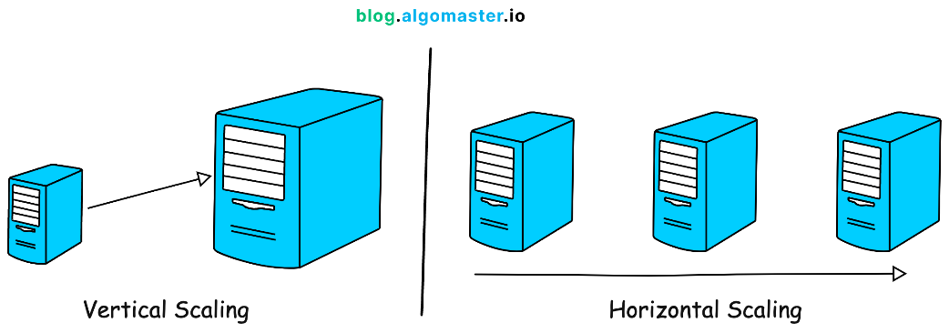
Software as a Service (SaaS)
Scalability & DevOps in SaaS
SaaS must handle unpredictable user growth and traffic spikes.
Scaling Methods
  Vertical Scaling – Increase Server power (Limited and Costly)
  Horizontal Scaling - Add more servers (preferred for cloud SaaS)
DevOps Practices
CI/CD, Infrastructure as Code, Containerization, Monitoring and Observability

Slide 16
Question
Why is stateless service design critical for SaaS scalability?
A) Improves UI
B) Enables horizontal scaling without session dependency
C) Reduces database size
D) Prevents DDoS

Slide 17
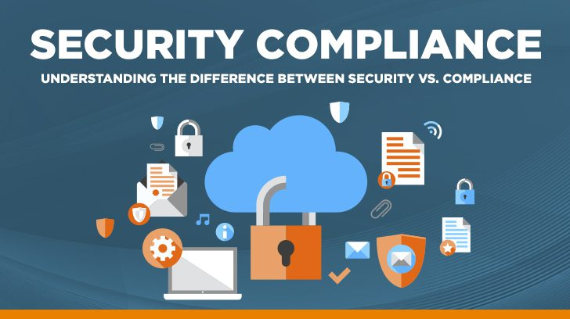
Software as a Service (SaaS)
Security & Compliance
SaaS security is complex due to multi-tenancy and internet exposure.
Major Threats
  Cross-tenant data leakage
  API attacks
  Insider threats
  Cloud misconfigurations
Compliance Frameworks
  GDPR
  POPIA
  SOC 2
  ISO 27001

Slide 18
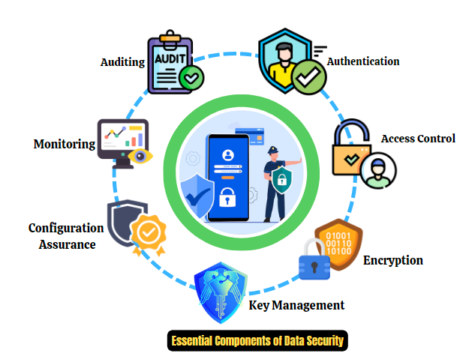
Software as a Service (SaaS)
Security Layers
Encryption
Role-Based Access Control
Tenant-scoped authorization
Logging & auditing

Slide 19
Question
Which failure is MOST catastrophic in multi-tenant SaaS?
A) Slow response time
B) Minor UI bug
C) Cross-tenant data exposure
D) Temporary outage

Slide 20
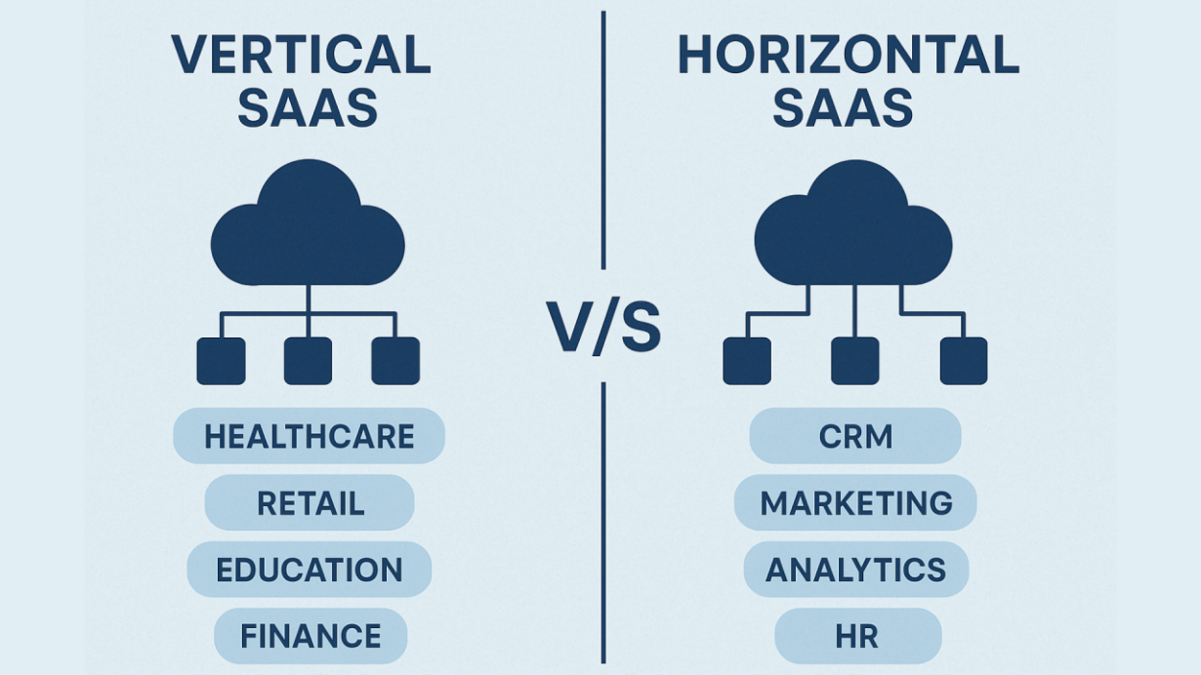
Software as a Service (SaaS)
SaaS Market Strategy
Horizontal SaaS
Vertical SaaS

Slide 21
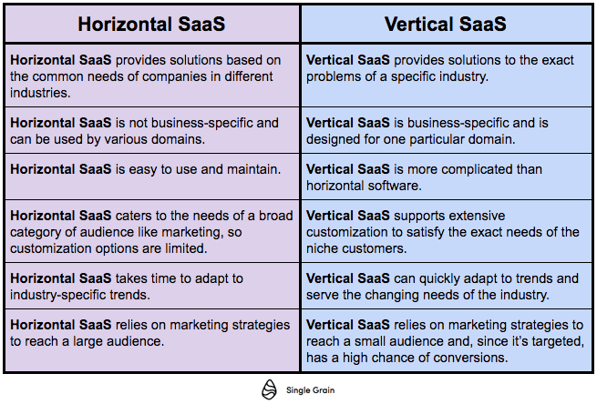
Software as a Service (SaaS)

Slide 22
Question
Why does Vertical SaaS often have lower churn?
A) Cheaper pricing
B) Larger customer base
C) Deep workflow integration
D) Less competition

Slide 23
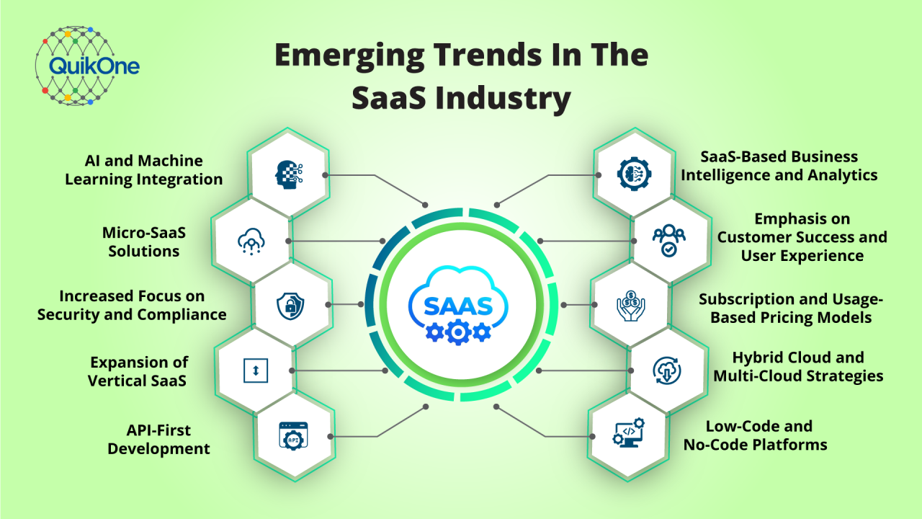
Software as a Service (SaaS)
AI-native SaaS, Usage-based billing, API-first products, Vertical AI agents

Slide 24
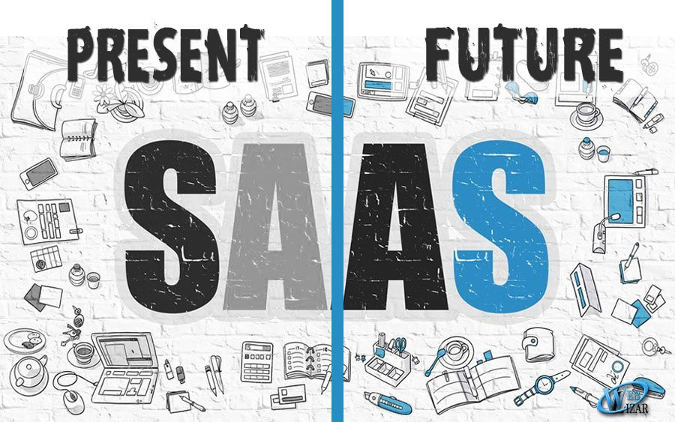
Software as a Service (SaaS)
The brighter side of SaaS
Reduction in initial costs from the development, deployment, and maintenance of software applications.
For business access to more and better tools through SaaS can only accelerate innovation – AI, IOT and Big data tools
Perfect tools for a mobile and remote workforce (before the global Covid19 pandemic).
Modified to fit the needs of a business and the needs of individual workers

